Slide 1
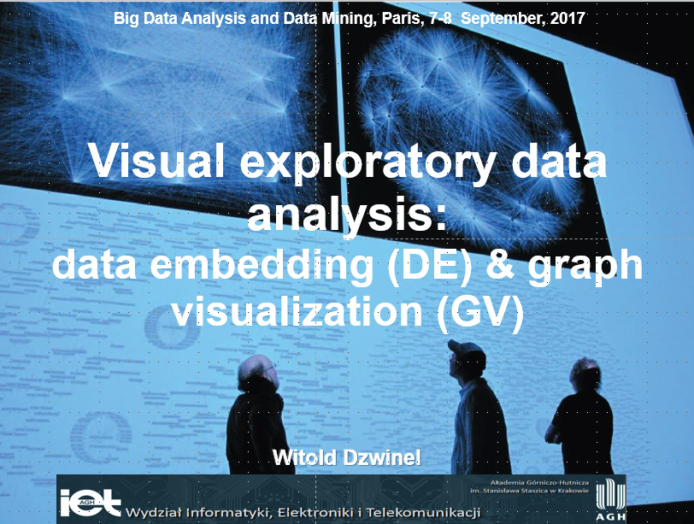

Slide 2
Organizacja zajęć
1. Wykład sobota (4 godziny) – „Wizualizacja wielo-wymiarowych zbiorów danych”.
2. Ćwiczenia niedziela (4 godziny) – wizualizacja małych zbiorów danych (Orange, soft).
3. Ćwiczenia sobota (4 godziny) Wizualizacja dużych zbiorów danych i grafów (ivta, Gephi, ivga).
4. Projekty samodzielne (Orange, Gephi)
Linki: https://gephi.org/users/download/, https://orange.biolab.si/download/windows/
Ivta, ivga, dane → Moodle

Slide 3
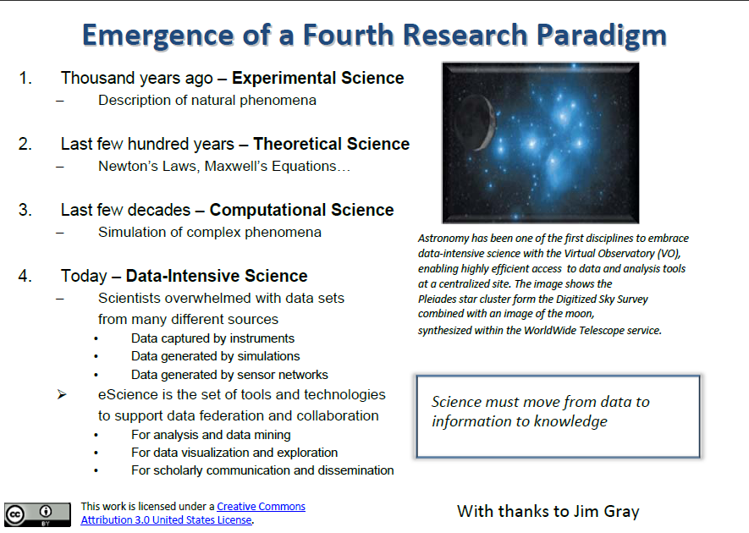

Slide 4
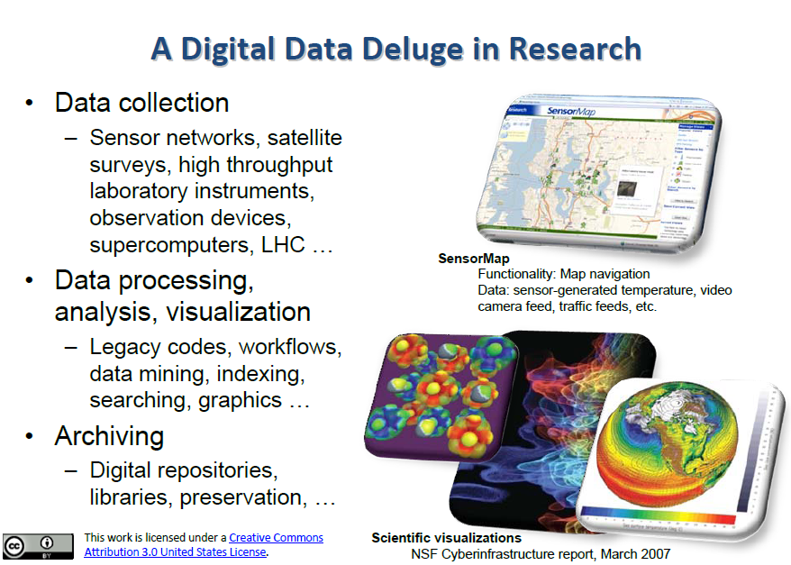

Slide 5
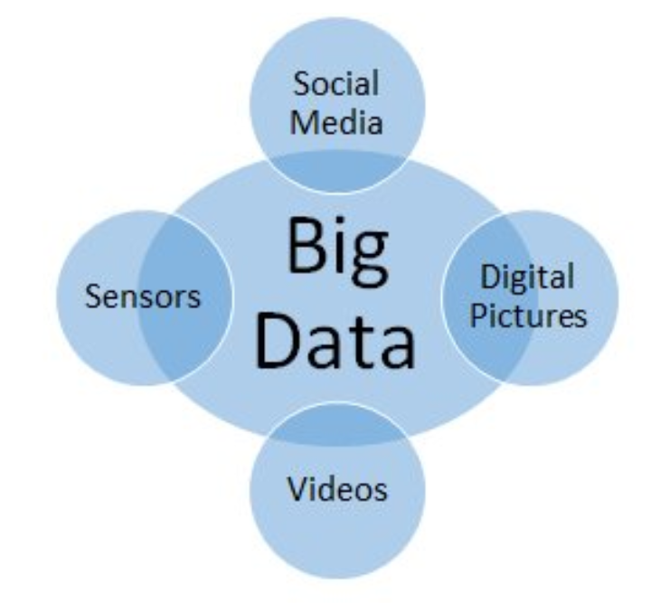
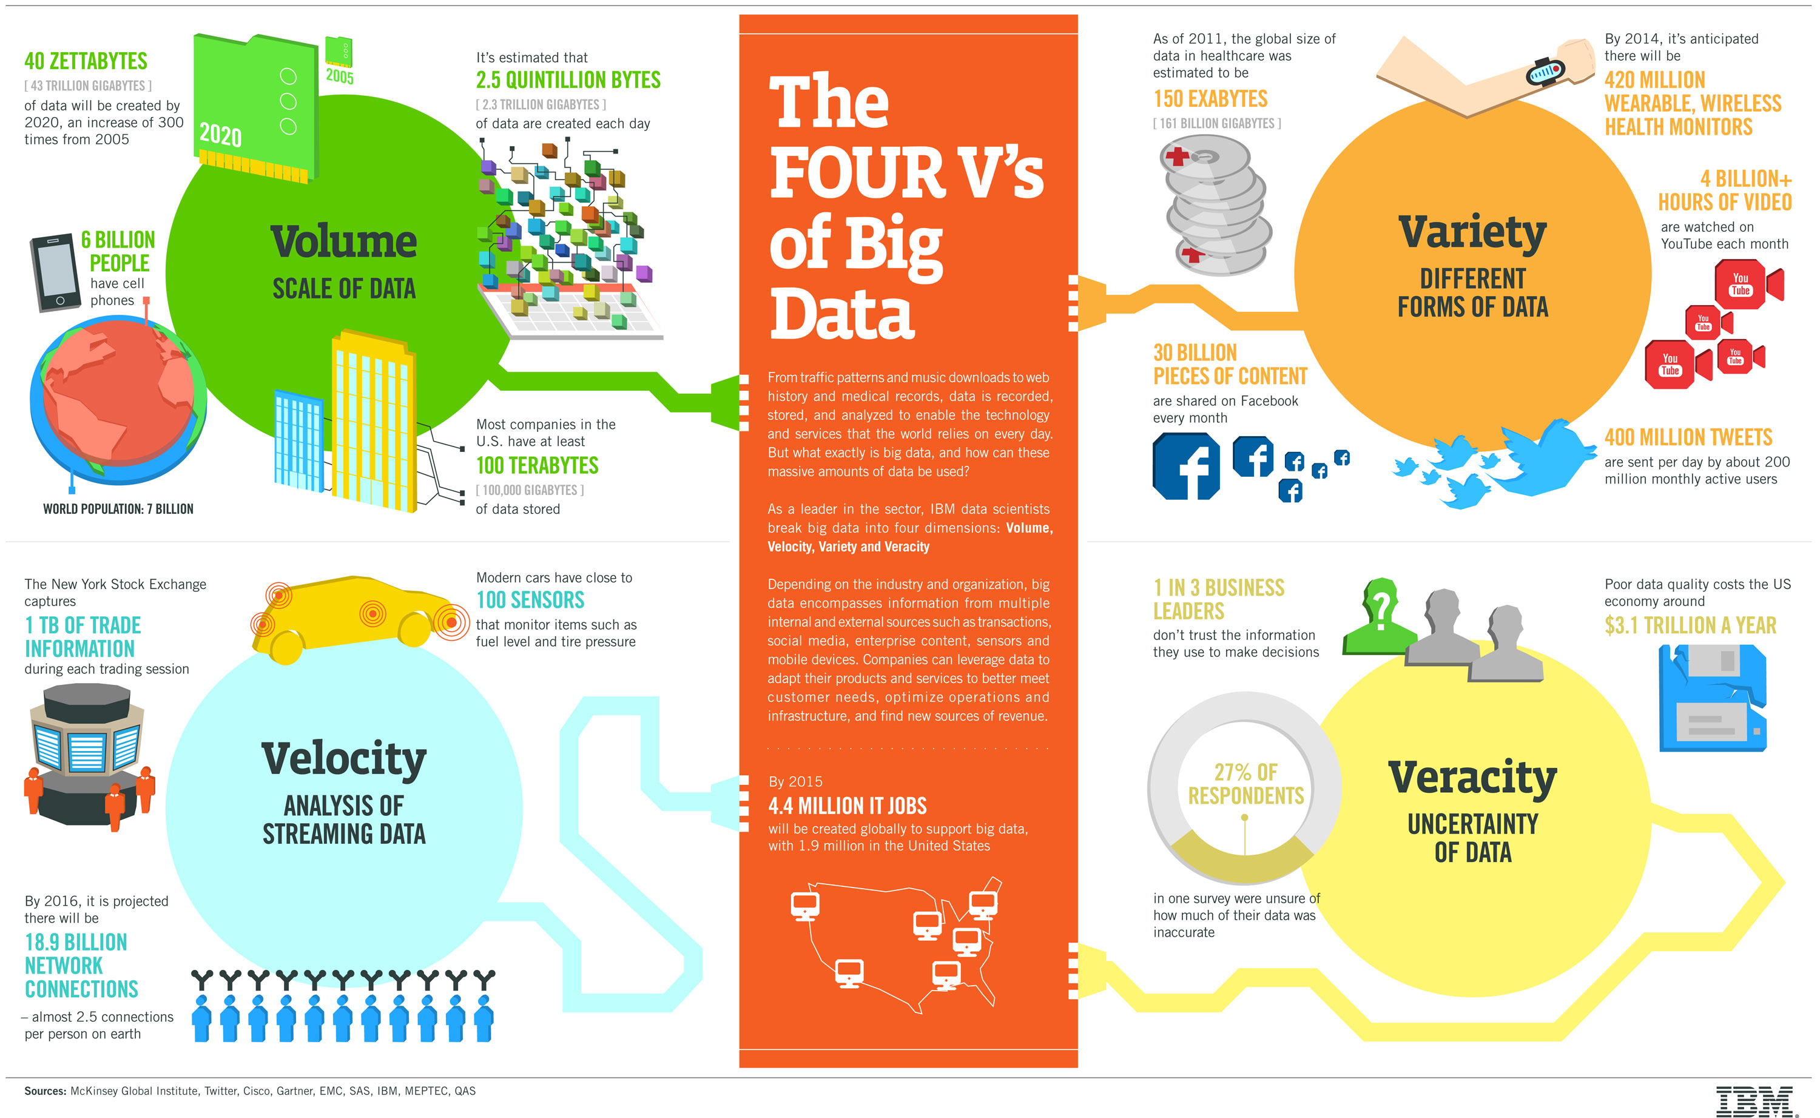
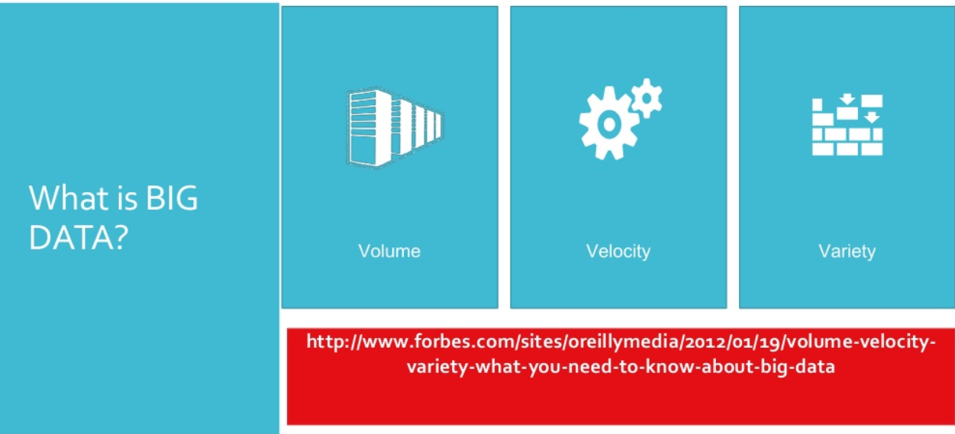
Big data

Slide 6
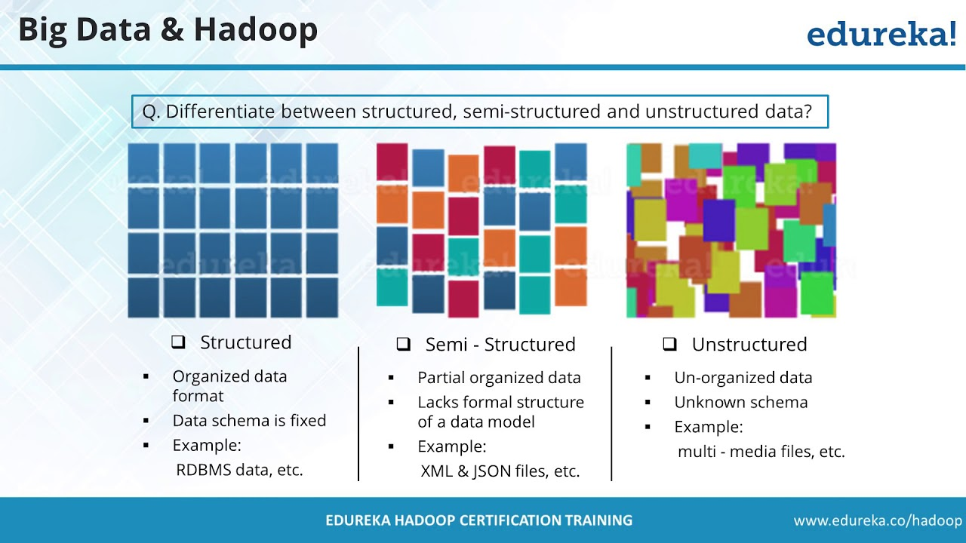
Data types

Slide 7
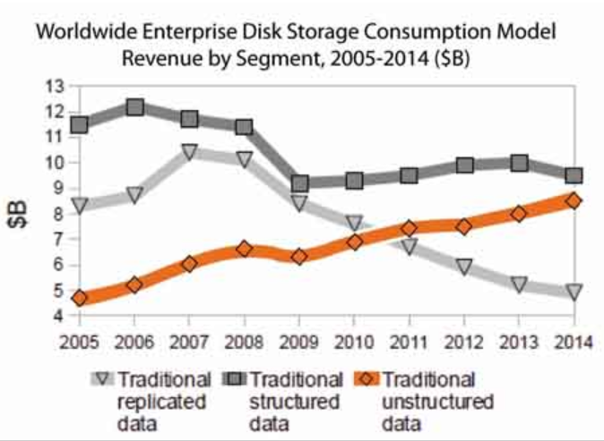
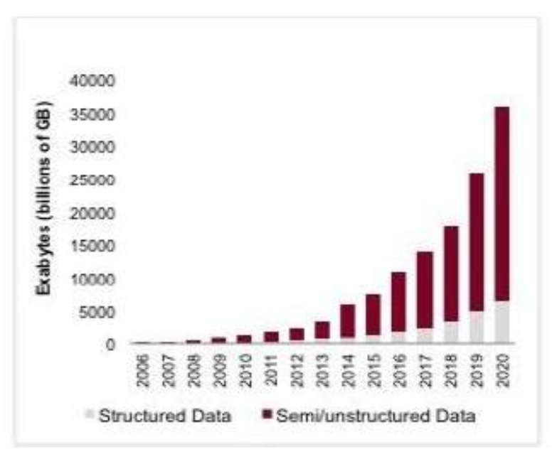

Slide 8
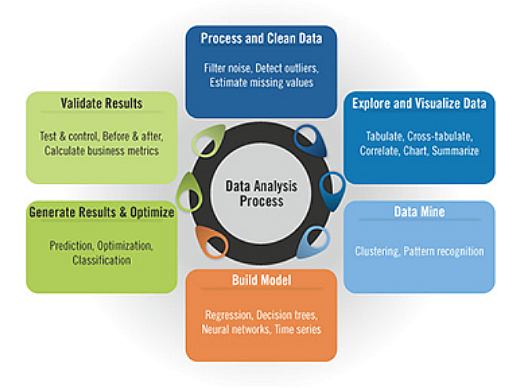
Data analytics

Slide 9
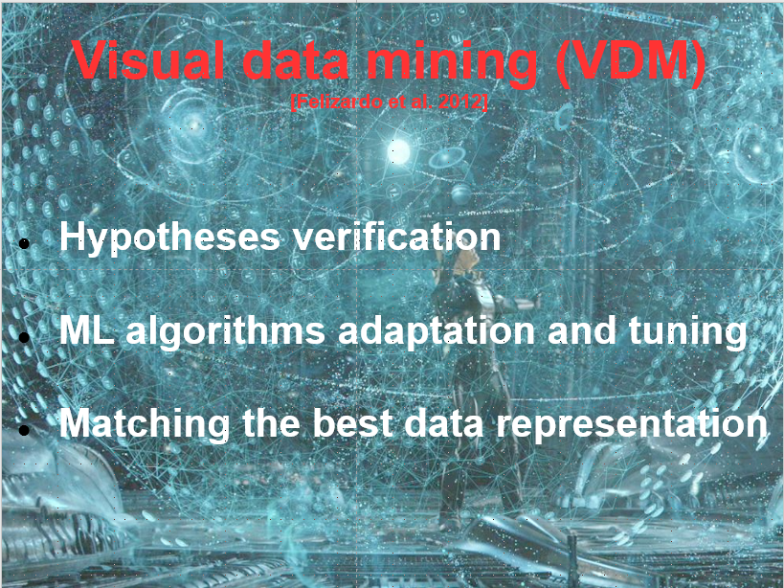

Slide 10
Visualization
How to represent various type of data?
Structured - multidimensional
Unstructured (text)
Heterogeneous
Data streams
How to visualize big data?
Multi-scale visualization
Interactive visualization
Context visualization

Slide 11
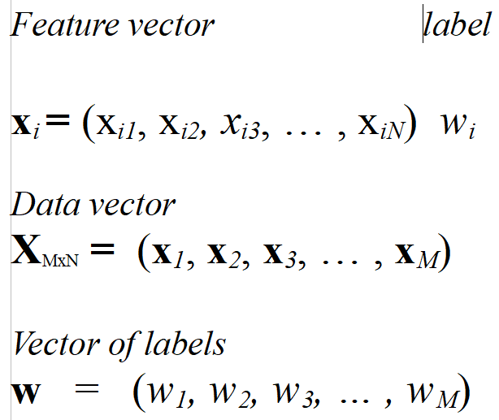
Vectors→data representation

Slide 12
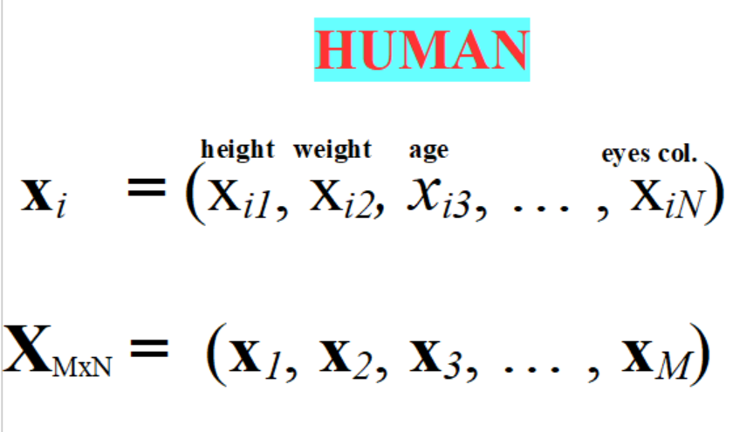
Vectors→data representation

Slide 13
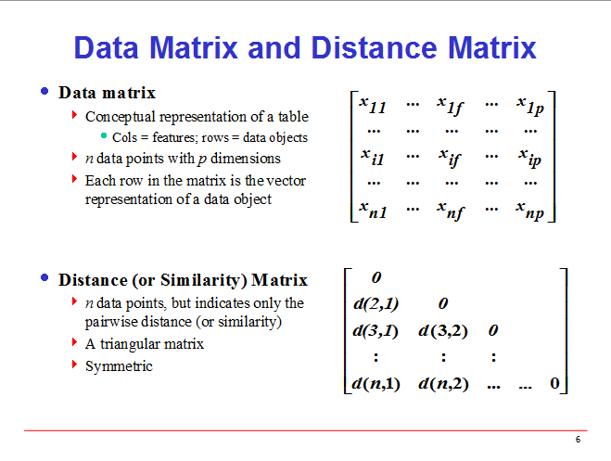
Notes:
13

Slide 14
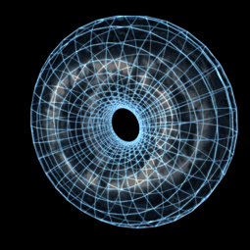
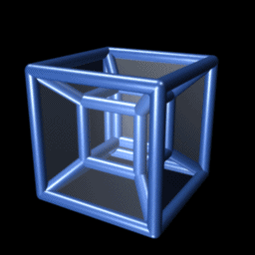
Multi-dimensional space

Slide 15
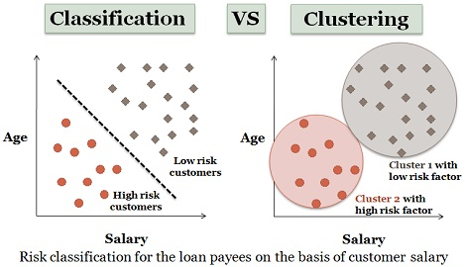
What are we looking for?

Slide 16
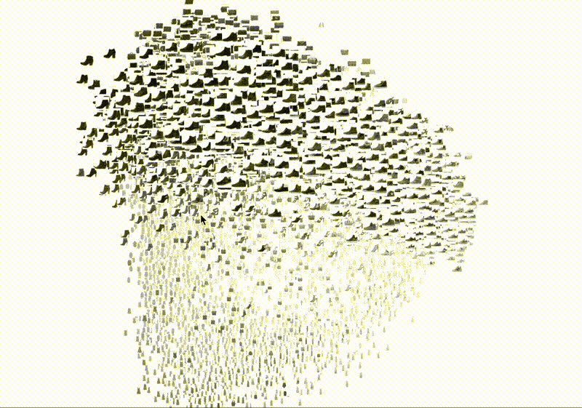
Classes recognition

Slide 17
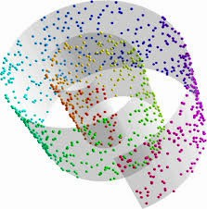
Data seem to be messy

Slide 18
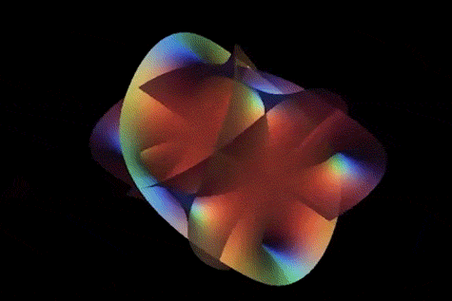
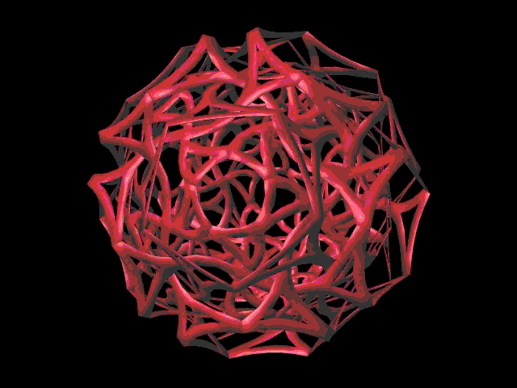
Manifold detection

Slide 19
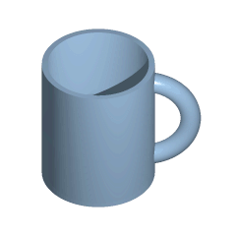
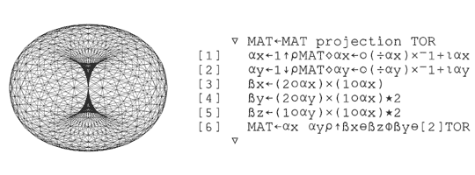
Manifold unfolding

Slide 20
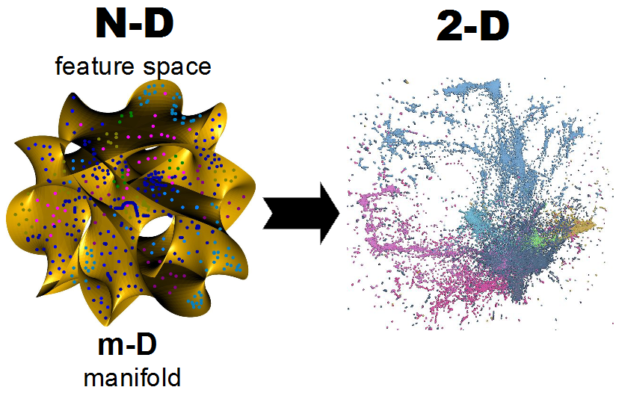
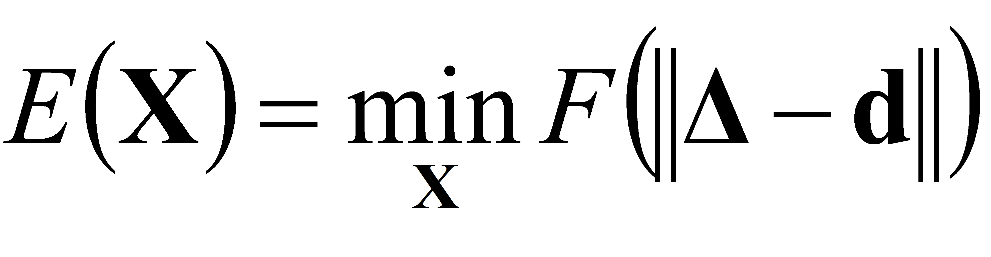
Topic → interactive visualization via embedding of large high dim data

Slide 21
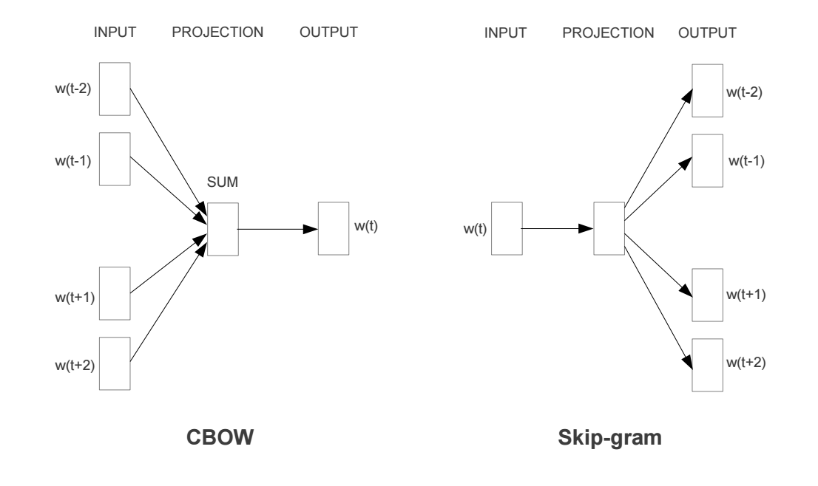
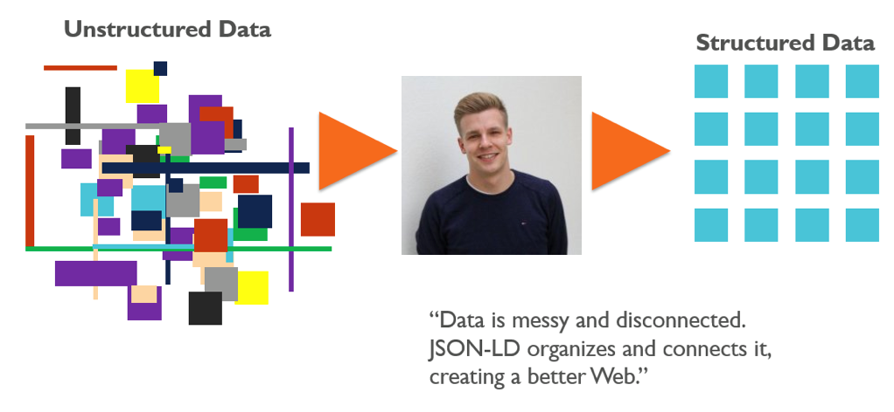
Data embedding

Slide 22
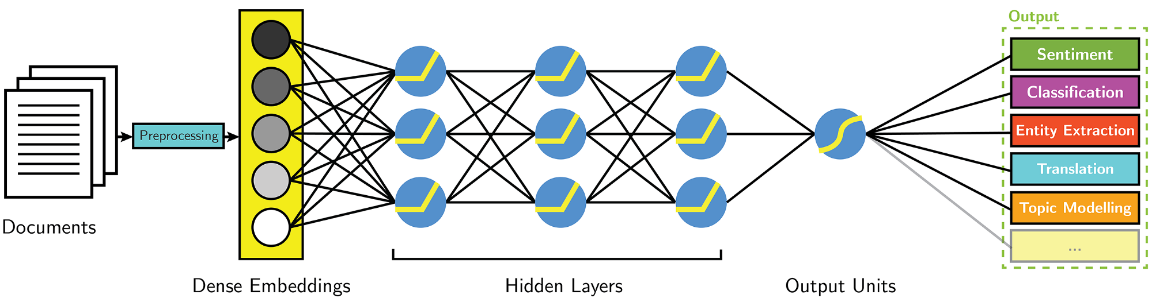
Embedding and processing

Slide 23
Multidimensional data
visualization

Slide 24
Notes:
24

Slide 25
Multi-dimensional data visualization
Three common ways to visualize multi-dimensional data:
Parallel Coordinates
Star glyph plots
Scatter-plot Matrix

Slide 26
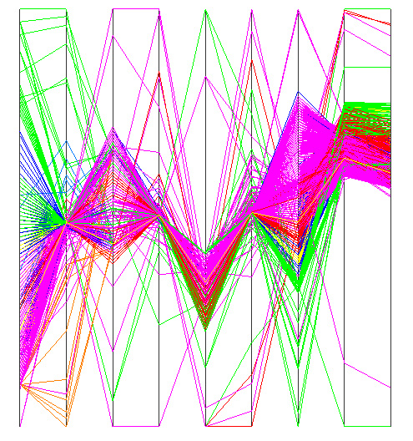
Parallel Coordinates
In Parallel Coordinates, each dimension is denoted by a vertical axis.
Each object is represented as a poly-line. The y-coordinate of the poly-line on axis-i is its normalized value in dimension d_{i}.

Slide 27
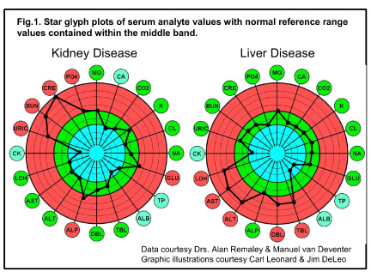
Star glyph plots

Slide 28
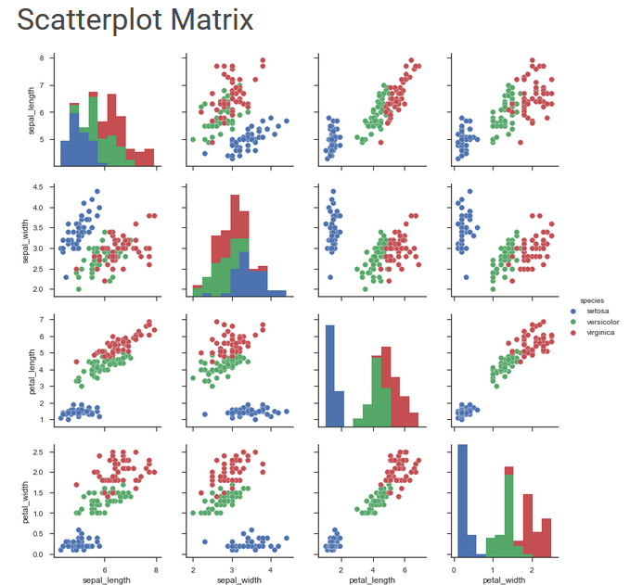
Scatter-Plot Matrix

Slide 29
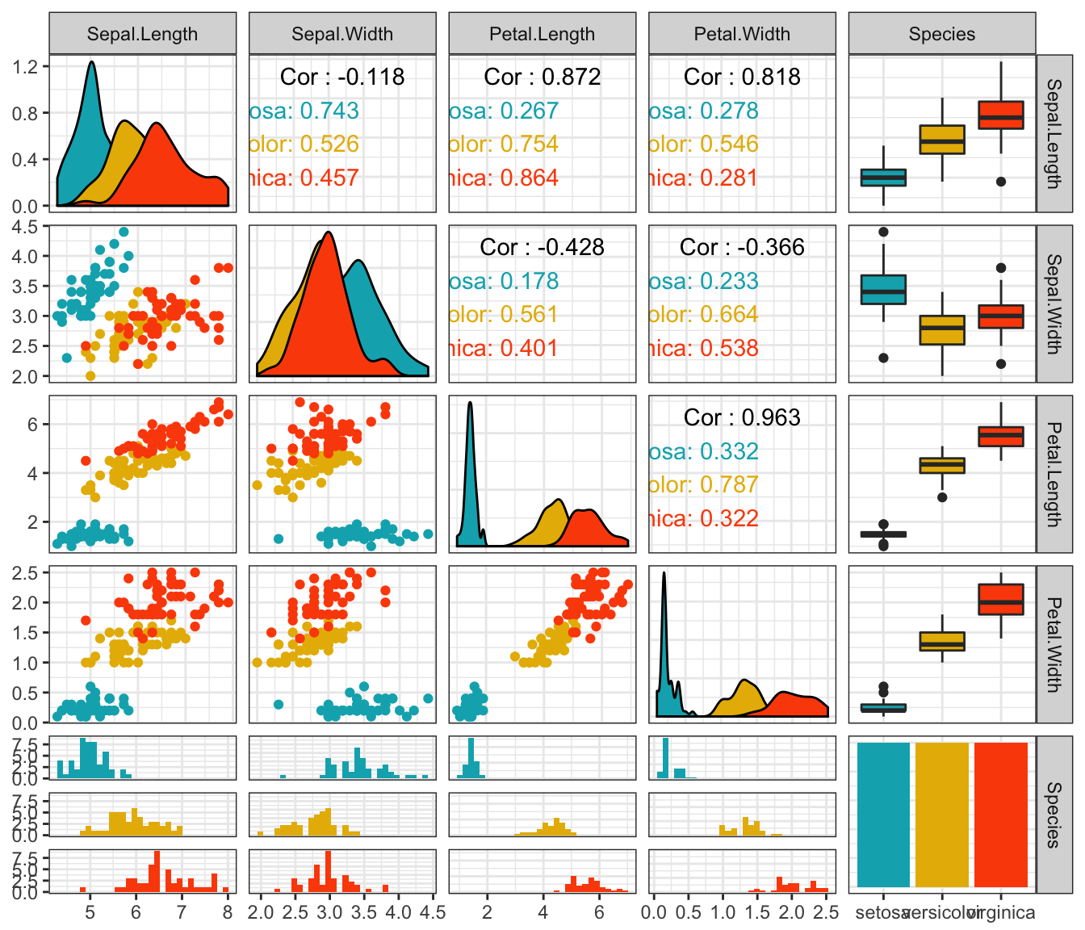
Scatterplot matrix extended

Slide 30
Multidimensional data visualization – larger data
Random projection (RP)
PCA
Classical MDS
Inne
Isomap (manifold distances)
Sammon and Niemann MDS (stress function)
Landmark and Pivot MDS
LLE (locally linear embedding)
t-SNE and its clones

Slide 31
Lemat Johnson-Lindenstrauss
For every 0< ε <1 and a set V of n, N-D data,
a mapping f: R^{N}→R^{M} exists, where:
M ≥ 4 (ε ²/2 - ε ³/3)⁻¹ ln n
for which
Notes:
31
31

Slide 32
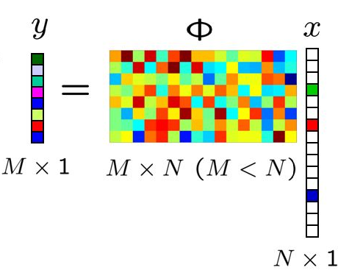
Random projection

Slide 33

K-L - Algorithm
X={x₁,…,x_{M}} x_{k}={x_{k,1},…,x_{k,N}}
Compute covariance matrix R_{i,j}=E(x_{i},x_{j}} (NxN)
Solve Rv=lambdav, find the largest lambda_{i} and corresponding v_{i} {i=1,…,m}
Transformation matrix A ={v₁,…,v_{n}}
y_{i}= Ax_{i}, i=1,…,N
visualize y_{i}
Witold Dzwinel
33
Notes:
33
w

Slide 34
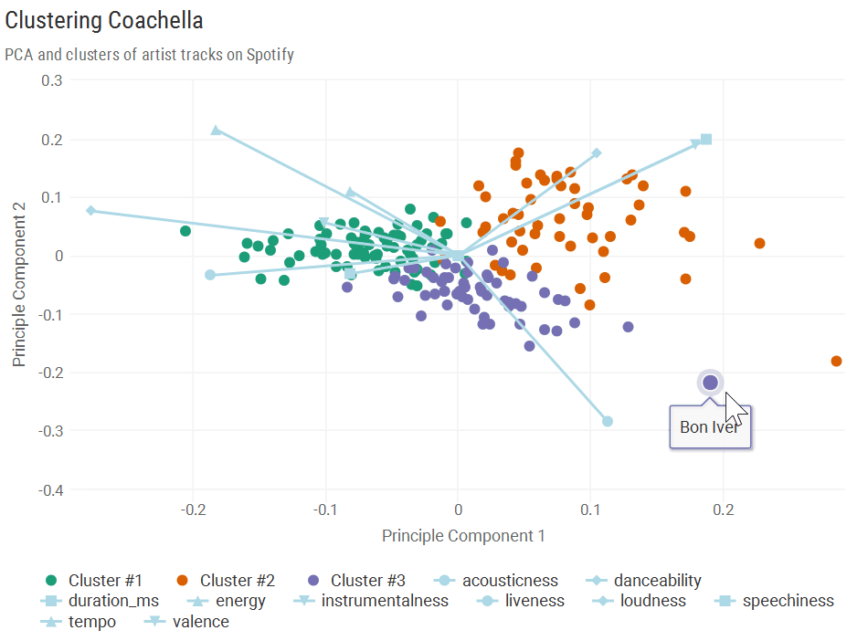
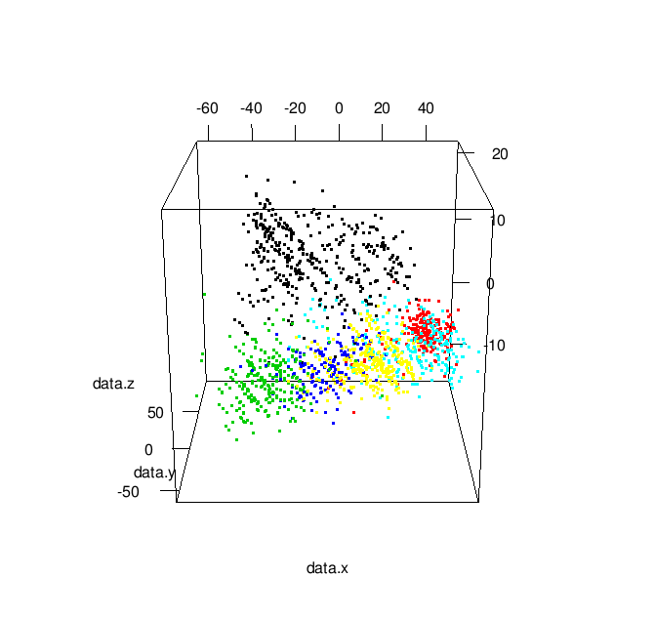
Principal Component Analysis

Slide 35
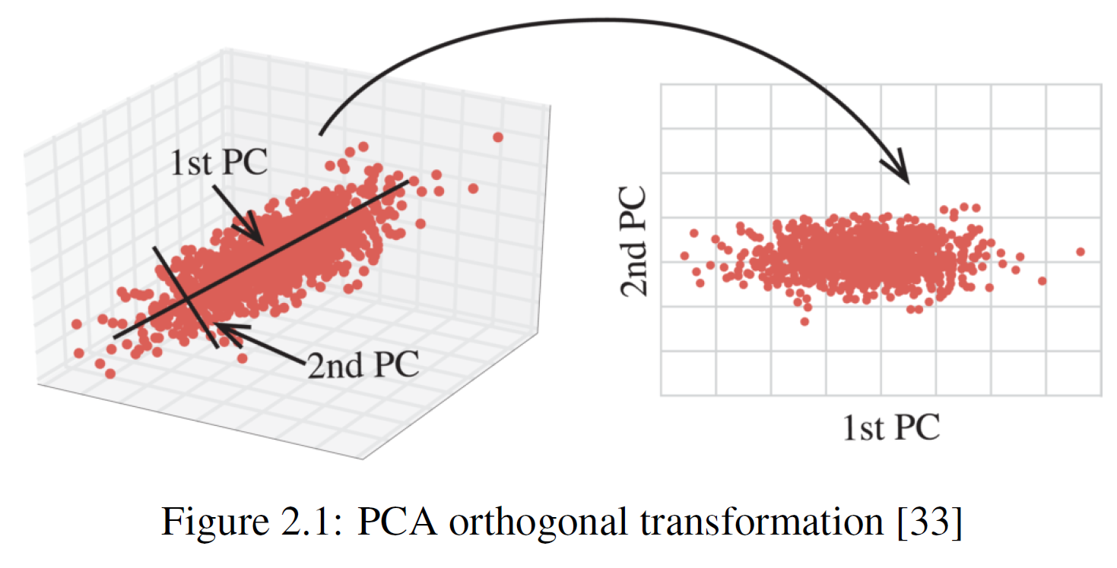
Principal Component Analysis

Slide 36
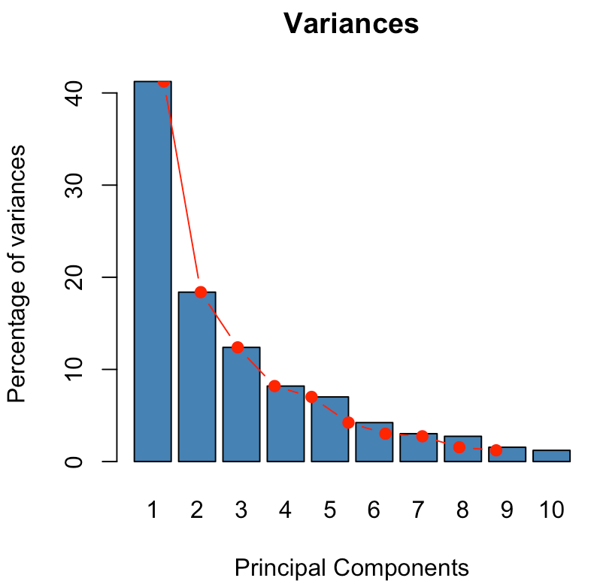
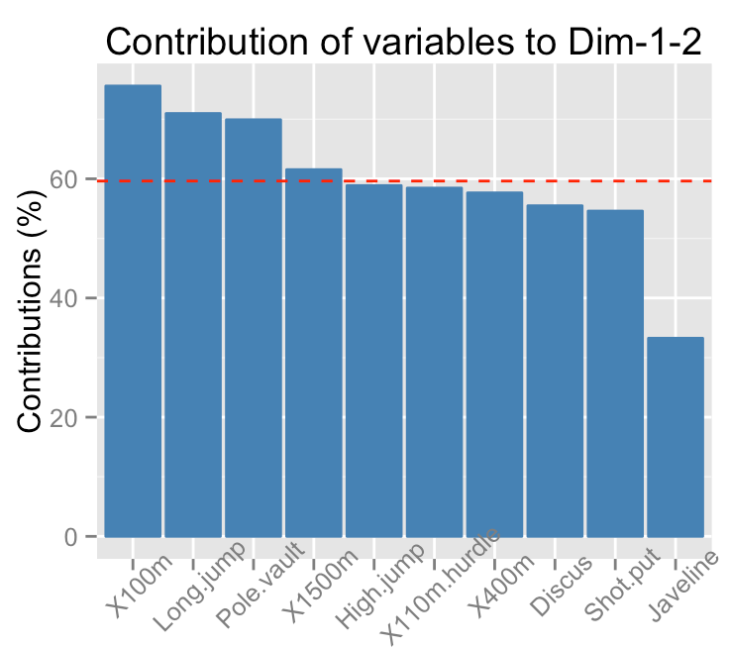
Eigenvalues → contribution

Slide 37
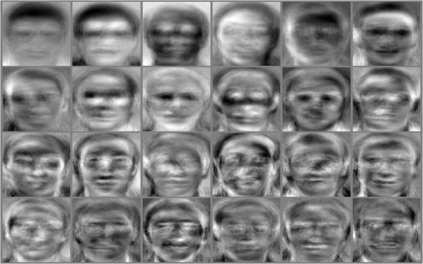
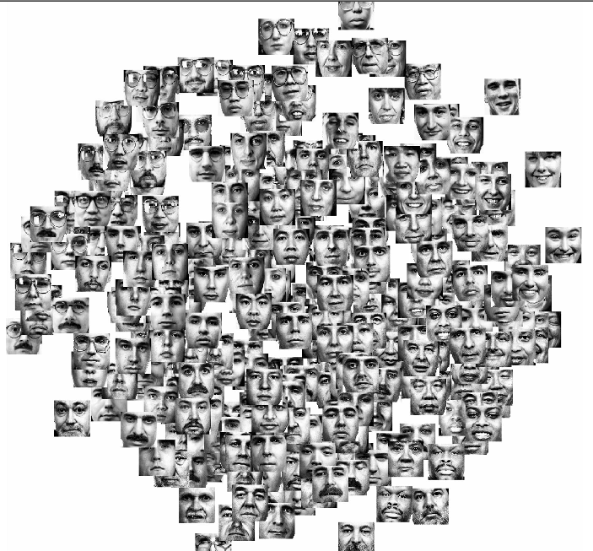
Witold Dzwinel
37
Notes:
37

Slide 38
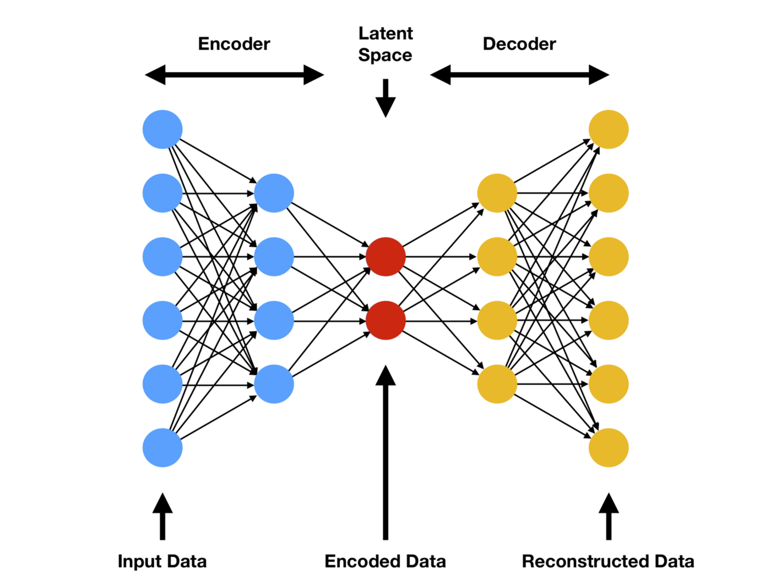
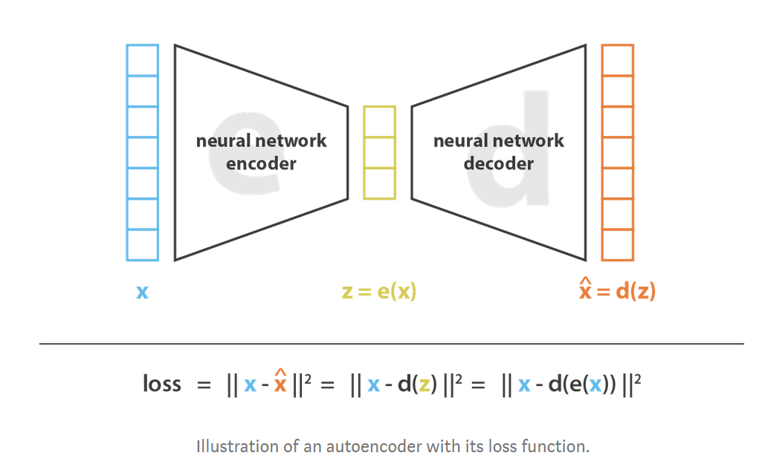
NN autoencoders

Slide 39
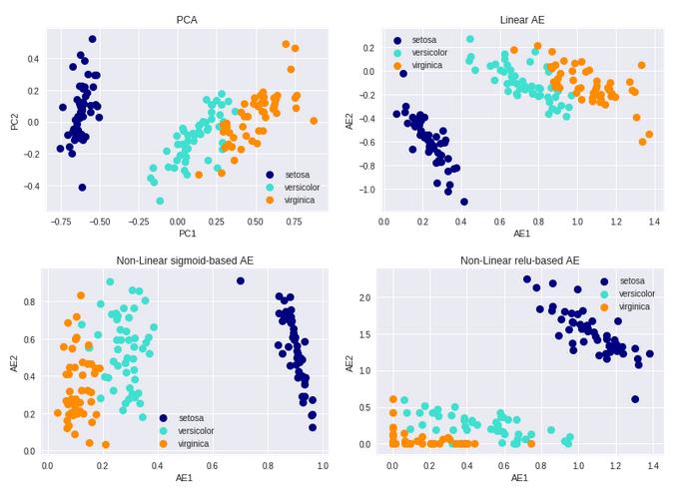
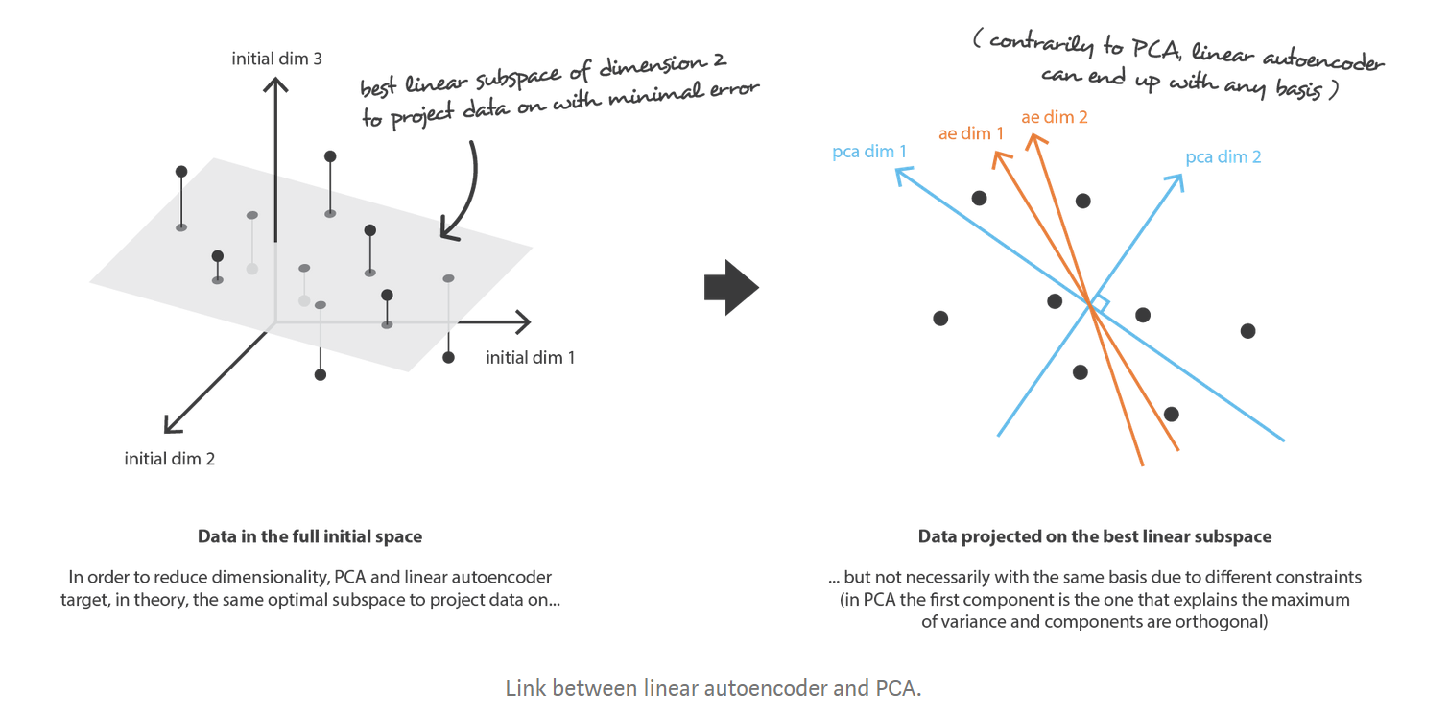
PCA and NN autoencoder

Slide 40
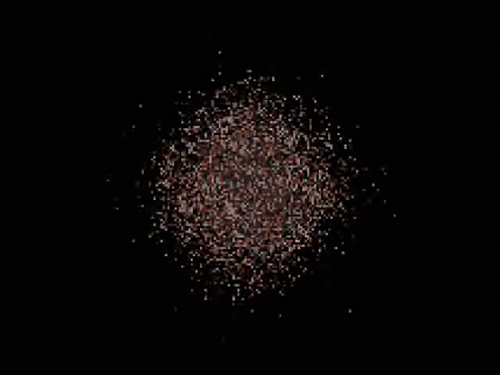
Notes:
40

Slide 41
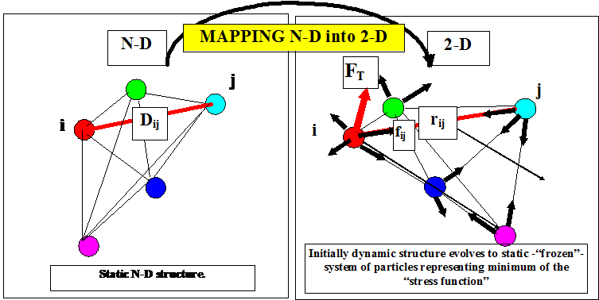
Multidimensional scaling
Dzwinel W, Blasiak J, Future Generation Computers Systems, 15, 365-379, 1999

Slide 42
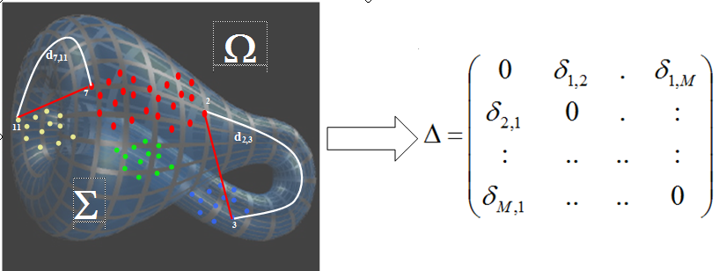
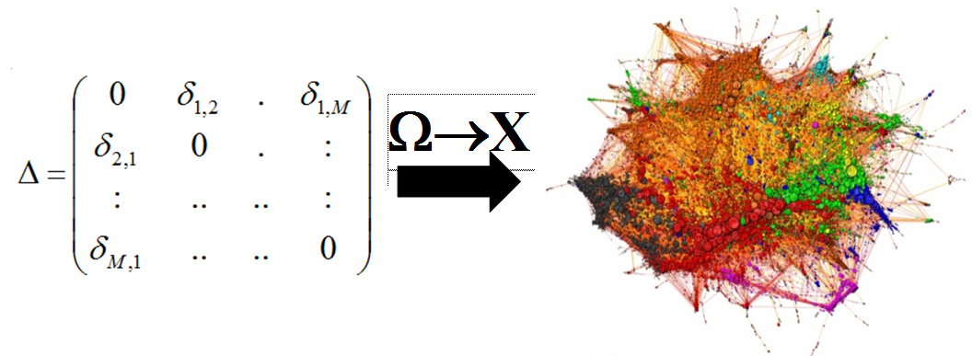
Ω→X mapping
Dzwinel,W, Yuen, D.A., Boryczko, K., Ben-Zion, Y., Yoshioka, S., Ito, T., Nonlinear Processes in Geophysics, 12, 117-128, 2005

Slide 43
Kruskal MDS and NLM
Kruskal – classic MDS
metric MDS – gradient method
2. non-metric MDS – increasing order sorted list of distances between all points pairs – position on the list → terminal distances
3. Sammon non-linear mapping (NLM)
Notes:
43

Slide 44
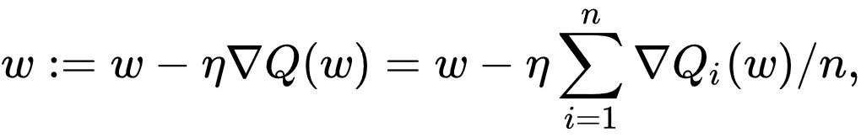
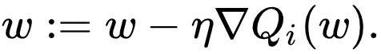


Minimization of stress function
Gradient descent
Stochastic gradient descent
Momentum method
Nestorov gradient descent, ADAM, AdaGrad, RMSProp

Slide 45

MDS

Slide 46

CDA (Curvilinear Distance Analysis)
Improved CCA
Curvilinear distances are computed on the manifold
Every point is connected to k nearest neighbors (Euclidean distance between nodes)
Notes:
46

Slide 47

CDA(2)
Curvilinear distance between points is equal to the length of the shortest path between these points
Notes:
47

Slide 48


Slide 49


Slide 50


Slide 51

LLE

Slide 52


Slide 53

Validation - descriptors
trustworthiness and continuity
trustworthiness – k-NN in target space are also its k-NN in source space
continuity – k-NN in source space are also its k-NN in target space
Shepard diagram (diagram „dy – dx”)
Notes:
53
Pewność ciągłość

Slide 54


Slide 55

Examples
Arodz, Boryczko, Dzwinel, Kurdziel, Yuen: IEEE Visualization 2005: 90

Slide 56

Robustness of MDS

Slide 57
Vector embedding (VE) problems
1. Curse of dimensionality dim Ω =N>>100
(Euclidean distances between N-D data → the same)
2. Complex manifold structure
3. O(M²) memory& O(MlogM) computational complexity
4. Multidimensional&multimodal optimization problem
Solution: Radical decrease of complexity of data embedding to O(M)

Slide 58
State of the art → VE
Novel minimization criterion
t-SNE [Van der Maaten and Hinton, 2011], ws-SNE [Yang et al., 2015]
Not all distances computed
BH-SNE [Van der Maaten, 2014]: O(NlogN) SUBSET [Pawliczek, Dzwinel, 2034] O(N)
Approximate NN computation
Q-SNE [Ingramand Munzner, 2015]
Force-directed method for “stress” optimization
PM, FDM [Dzwinel and Błasiak, 1999; Andrecut, 2009]
f_{ij} = K * (D_{ij}^{k} – d_{ij}^{k})^{m} *r_{ij}

Slide 59
Novel minimization criterion – divergence
Stochastic Neighbor Embedding
t-Distributed Stochastic Neighbor Embedding
Symmetric SNE
Mismatched Tail can Compensate for Mismatched Dimensionalities

Slide 60

SNE Stochastic Neighbor Embedding

Slide 61


Slide 62


Slide 63


Slide 64


Slide 65


Slide 66


Slide 67

Crowding effect

Slide 68


Slide 69


Slide 70







Stochastic Neighbor Embedding
Data space
Map space
Cost function
Perplexity
Gradient descent method
70

Slide 71





Symmetric SNE (t-SNE)
To use Student-t distribution improve performance.
Cost function is difficult to optimize ⬅ Symmetrized
Crowding problem ⬅ heavy-tailed distribution
Cost function
Map space
Data space
Gradient descent method
71

Slide 72



Mismatched Tails can Compensate for Mismatched Dimensionalities (t-SNE)
Map space
Gradient descent method
72

Slide 73

Experiments
Data Sets
MNIST data set, Olivetti faces data set,
Experimental Setup
To use PCA to reduce the dimensionality
Cost function parameter settings
73
Notes:
73

Slide 74


Slide 75




Visualizations of 6,000 handwritten digits from the MNIST data set
Sammon mapping
t-SNE
Isomap
LLE
75

Slide 76

Visualizations of the Olivetti faces data set
t-SNE
Sammon mapping
Isomap
LLE
76

Slide 77

Visualizations of 70,000 handwritten digits from the MNIST data set

Slide 78


Slide 79

How to Use t-SNE Effectively

Slide 80

Other divergence criteria (bh-sne, ws-sne)

Slide 81

Graphs visualization

Slide 82


PCA based of ultra-fast method of graph embedding Harel, Koren, 2004

Slide 83


Ultra fast method of graph embedding

Slide 84




K-NN graph visualization

Slide 85



Force directed method

Slide 86


State of the art → GV
1. Force directed method (spring-electrical)
Fruchterman and Reigold [1991]
2. Not all distances computed
Burnes-Hut approximation: [Y.Hu, 2006]
3. Big GV millions of nodes and edges
The University of Florida Sparse Matrix Collection
https://www.cise.ufl.edu/research/sparse/matrices/

Slide 87
O(M²) memory& O(MlogM) computational complexity do not allow for using VE for BIG DATA visualization
Solution:
Radical decrease of complexity of data embedding to O(M)

Slide 88

Concept
VE and GV methods are strongly overdetermined. In n-D only:
distances define the stable solution
Which distances?????

Slide 89

Not all distances computed
Selected distances
Landmark/SUBSET

Slide 90

MDS → reduced dissimilarity array
MDS →random distances selection

Slide 91


Histogram of distances in N-D MNIST data set
What is the distance of two random points hanging on the surface of a unit 1000D sphere?

Slide 92



Concept
1. ∀i, find n-NN_{i} and r-RN_{i} (which are not n-NN)
2. Use force directed method
n indices of n-NN_{i} (n=2,3 for 2-D embeddings)
r indices to r-RN_{i} (r = 1)

Slide 93

Proof of concept

Slide 94




MNIST
a
3 h
b
c
12 s
a) DBN (M=7000) b) BH-SNE (M=70000) [Van Maaten, 2014] c) nr-MDS (M=70000)

Slide 95

NORB (small)
M=43600, N=2048
The NORB dataset (NYU Object Recognition Benchmark) contains stereo image pairs of 50 uniform-colored toys under 18 azimuths, 9 elevations, and 6 lighting conditions

Slide 96

DBN - autoencoder
[Snoek et al., 2012]

Slide 97



Autoencoder, Snoek et al.2012
NORB: 1m
Van der Maaten, 2014

Slide 98

Reuters
5 min

Slide 99



20NG
ws-SNE, Yang et al. 2014

Slide 100



Curse of dimensionality
ALL distances
3-NN distances

Slide 101


Graph visualization perspective
20NG - VE

Slide 102

20NG - DE
20NG - GV

Slide 103


Slide 104


Binary vs. Euclidean
NN in 2-D
all in 2-D

Slide 105


Approximate NN search (Q-SNE)

Slide 106

Big graphs (social networks)

Slide 107

State_of_the_art
2167.88 sec.
250 sec.
http://yifanhu.net/index.html
AT&T Labs -- Research

Slide 108


Slide 109


Slide 110


Slide 111

Big graphs (road network)

Slide 112

Pennsylvania road network

Slide 113



13 min 20 sec

Slide 114

http://yifanhu.net/index.html
AT&T Labs -- Research

Slide 115

History from Wikipedia

Slide 116

History visualization

Slide 117

History visualization

Slide 118

History visualization

Slide 119


Slide 120

Big data perspective

Slide 121
Conclusions
1. Low memory complexity O(nM)
2. Small computational complexity O((n+r)M)
3. High level of parallelization (PM)
4. Easy implementation on Big data platforms (Hadoop, Apache Spark)
5. Near neighbors (NeN) instead of NN!
6. Big graphs visualization

